Slide 1
Typographies
WEB
Couleurs
H1 Segoe Semi-Gras 48px
H2 Segoe Semi-Gras 39px
Dégradé #04001C #0D006F
Gris clair #E7EBEE
H3 Segoe Semi-Gras 31px
Cyan #03F7F0
Gris moyen #C9CBCD
Texte Segoe Semi-Gras 25px
Paragraphe Segoe Semi-Gras 20px
Blanc #FFFFF
Gris foncé #737373
Segoe Pro Light
Segoe Pro
Segoe Pro Gras

Slide 2



Slide 3



Suivez nous !
@MSReBUILD
Tweetez !
Je suis au #MSReBUILD avec @speaker @Nantesfr @Communautesms

Slide 4





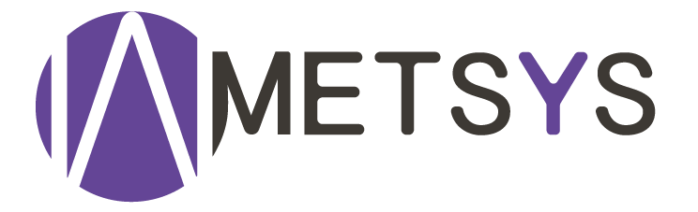
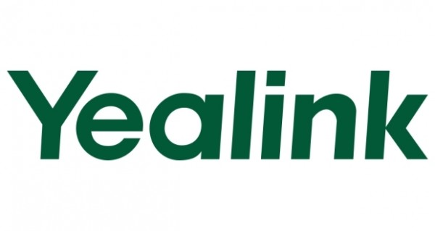
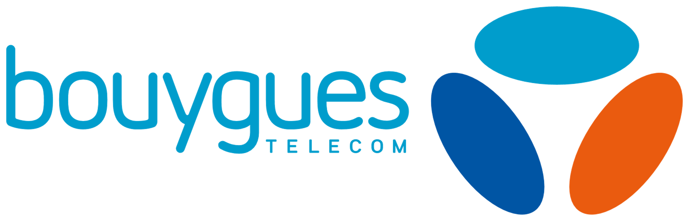

Merci à nos sponsors !

Slide 5
Dev et Ops dans le cloud : faites l’💖 pas la 🔫

Slide 6

Félix Billon
Freelance, MVP Microsoft, membre de la communautés aOS et co-organisateur du meetup Paris TypeScript. Consultant indépendant en tant que spécialiste dans le développement Web.

Slide 7

Yoann Guillo
Freelance, MVP Microsoft Azure, membre de la communautés aOS et co-organisateur du Microsoft User Group Rennes. Consultant indépendant en tant que Cloud Architect.

Slide 8
Agenda
DevOps ?
Le cas du cloud
Demo TIME !

Slide 9
DevOps ?

Slide 10

Les Dev vue par les Ops
Disent toujours que c’est la faute des Ops
Ne prennent pas en compte la sécurité
N’ont aucune notion de dimensionnement
Aiment la technique pour la technique

Slide 11
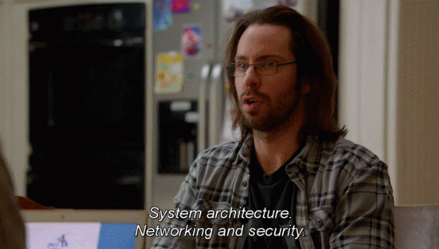
Les Ops vue par les Dev
Ne comprennent rien au développement
Disent toujours que c’est la faute des Devs
Veulent connaître le dimensionnement pour les 3 années à venir
Doivent avoir une barbe d’au moins 10cm de longueur pour être crédible

Slide 12
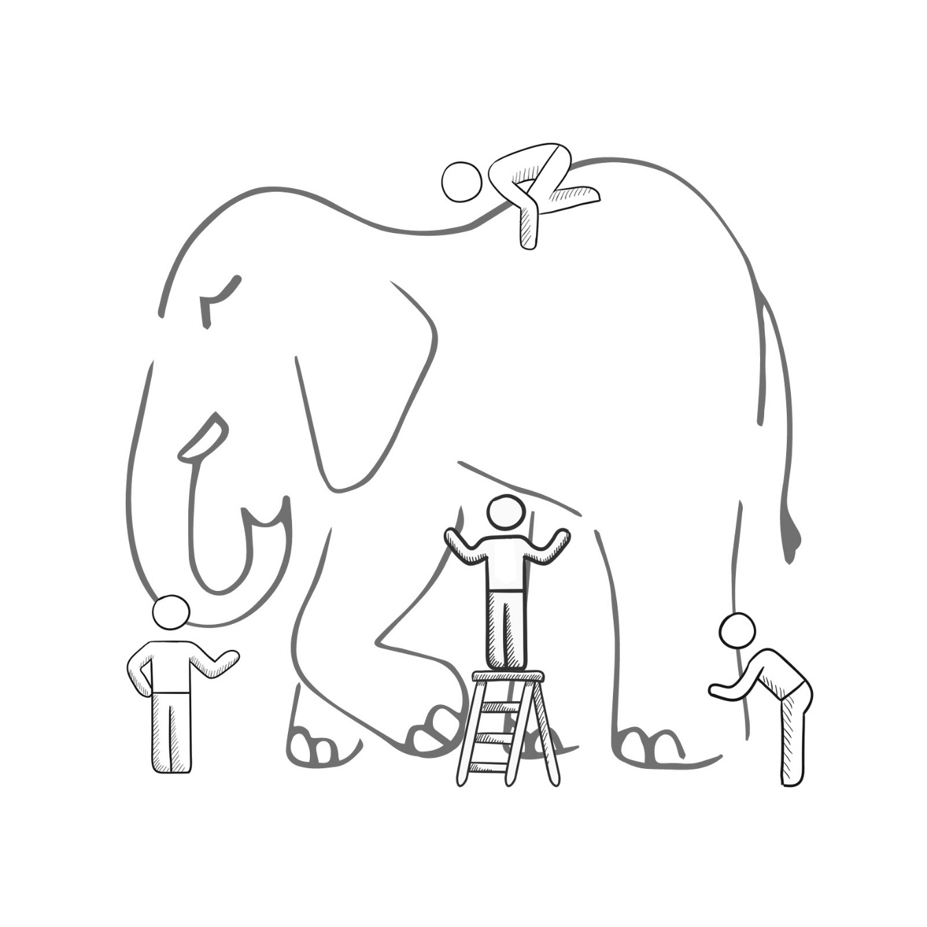
Le DevOps n’est pas…
It’s a job title
It’s automation
It’s Development and Operations collaboration
It means faster and smaller releases
Notes:
Now I've mentioned DevOps a lot, but what exactly is DevOps. I bet if I ask 10 people in this room what DevOps is, we will get 10 different responses. And I'm not saying anyone elses definition is wrong. But in order to frame this conversation we are having, let me give you Microsoft's Definintion of DevOps

Slide 13

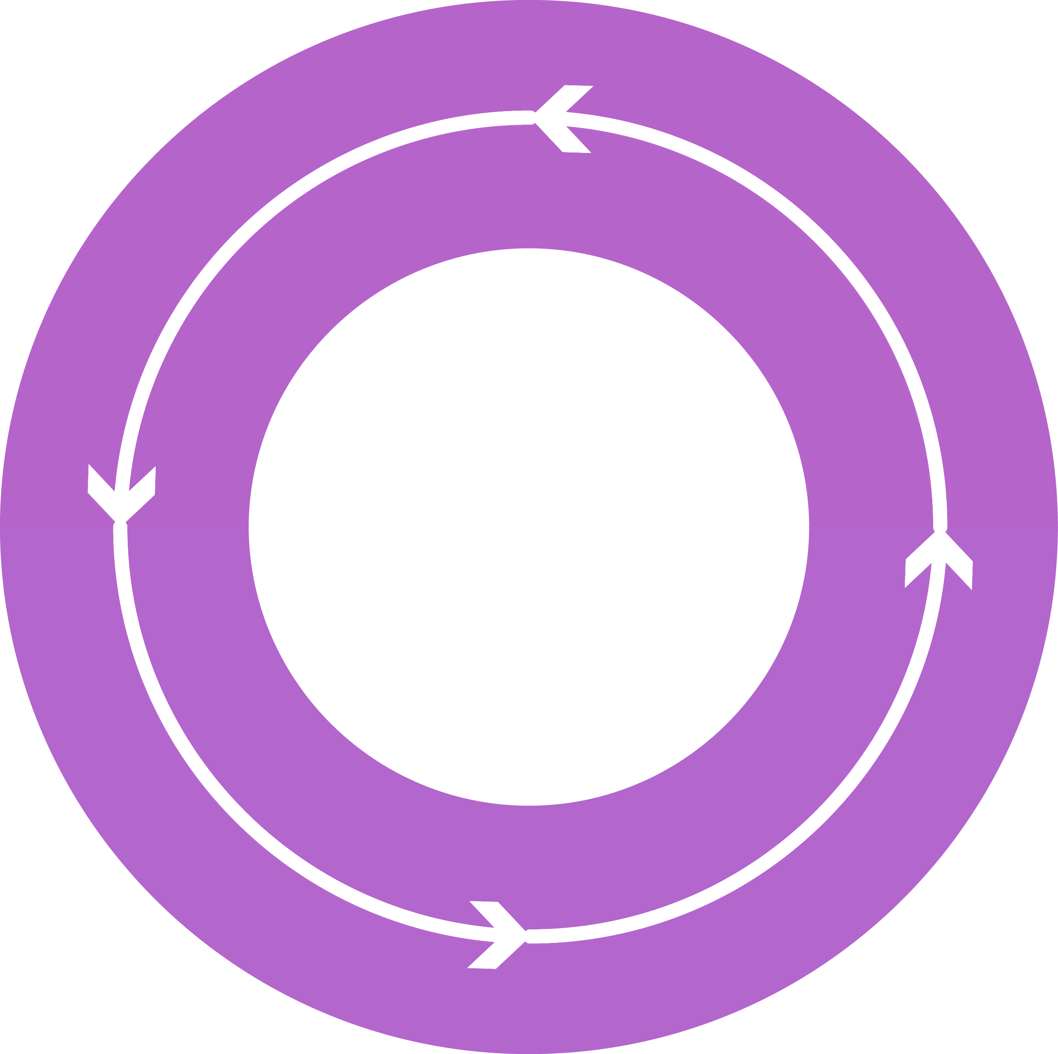
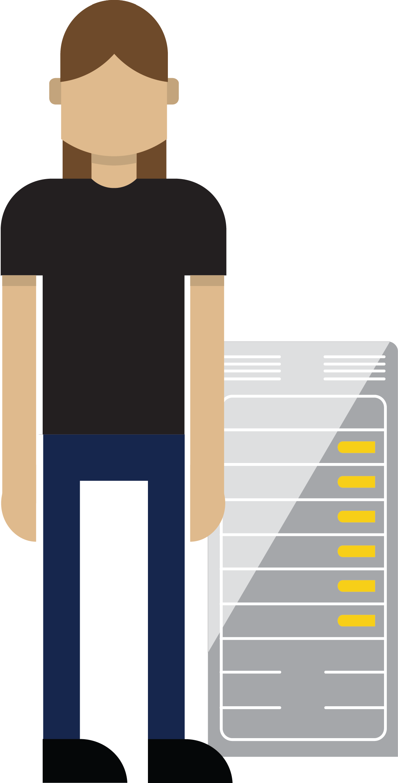



Le DevOps c’est…
DEV
OPS
1
People
2
Process
3
Tools
Notes:
Felix :
Une philosophie/mouvement/culture
Une concaténation du mot Developeur et Opérationel
Casser les barrière pour rassembler les Dev et les Ops
Accompagner par un ensemble d’outils qui facilite la chaine de production d’une application.

Slide 14
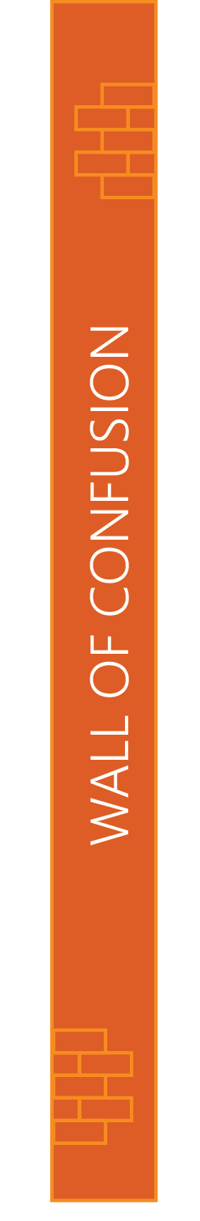
People
DEV
OPS
Notes:
Yoann :
For the people portion, that's the toughest change to make. This is a cultural shift that needs to take place in the organization. Where everybody from the top down all become hyperfocused on continuously delivering value. I don't want to hear, well, that's how we always do things from anyone. Everyone needs to focus on continuously delivering vaue.

Slide 15
Process
1
4
Plan
Monitor + Learn
Development
Production
2
3
Develop + Test
Release
Notes:
For the process, we need to have a process that will let us interate fast enough, yet still deliver code of high enough quality. So what does that mean? I need to be able to plan my sprints, and I need to be able to check my code in and out while tracking against the work I'm doing. And as I'm checking code in and out? Builds need to kick off. Automated Tests need to be run. Security scans need to happen. And if the build are good, an automated system needs to pick up my bits and deploy them into my Dev, QA, UAT all the way out in to production. And why does this need to be automated? Potentially, this can happen many times a day! So we need to make sure the process is consistent and repeatable. Every single time like clock work. And once the code reaches production, it doesn't end there. We still need to be able to monitor our code in production. We need to know things like, is my app up or down, is my app performing well, and what are users really doing in my app? Because answers to those questions let me know if I'm delivering vaue to my end users. And if I am, we can double down on those types of activities in the next sprint. And if we aren't, then we can quickly reprioritize our backlog and course correct.

Slide 16
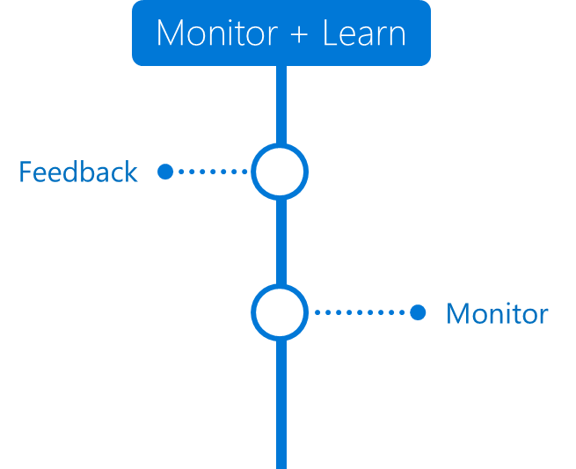

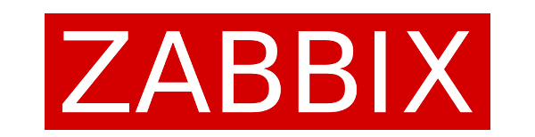
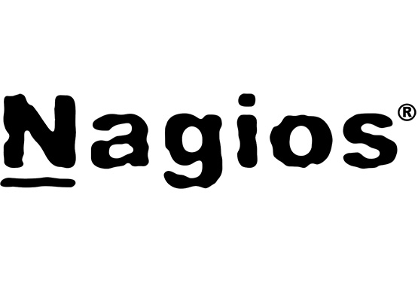
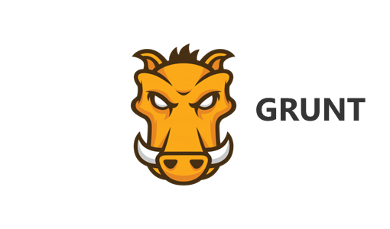
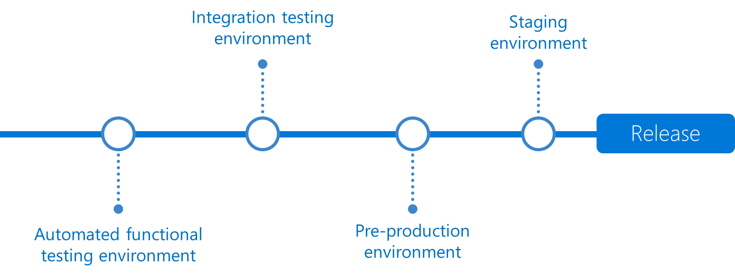
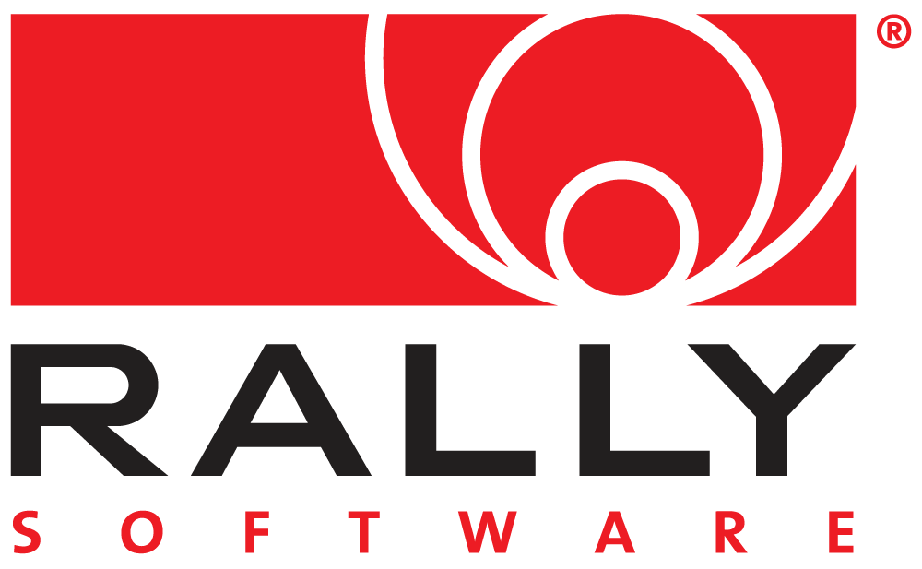
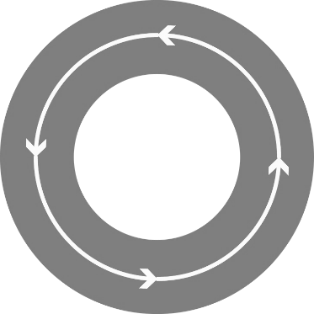

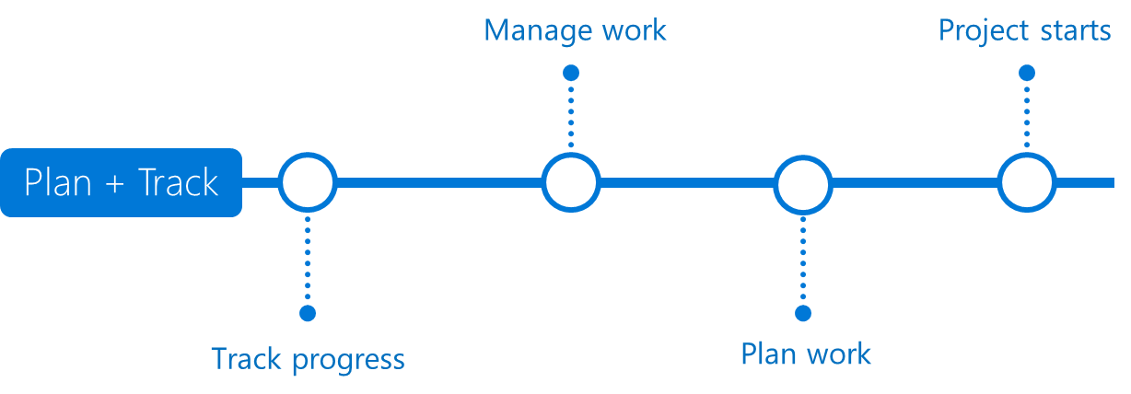

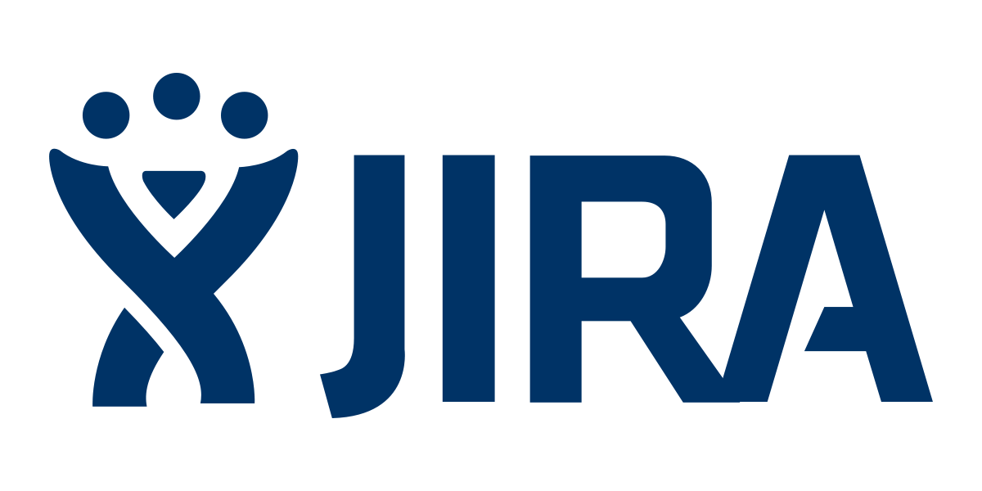
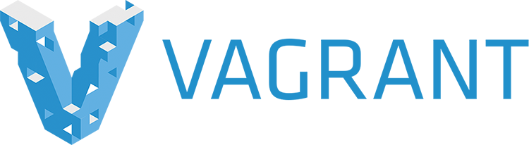




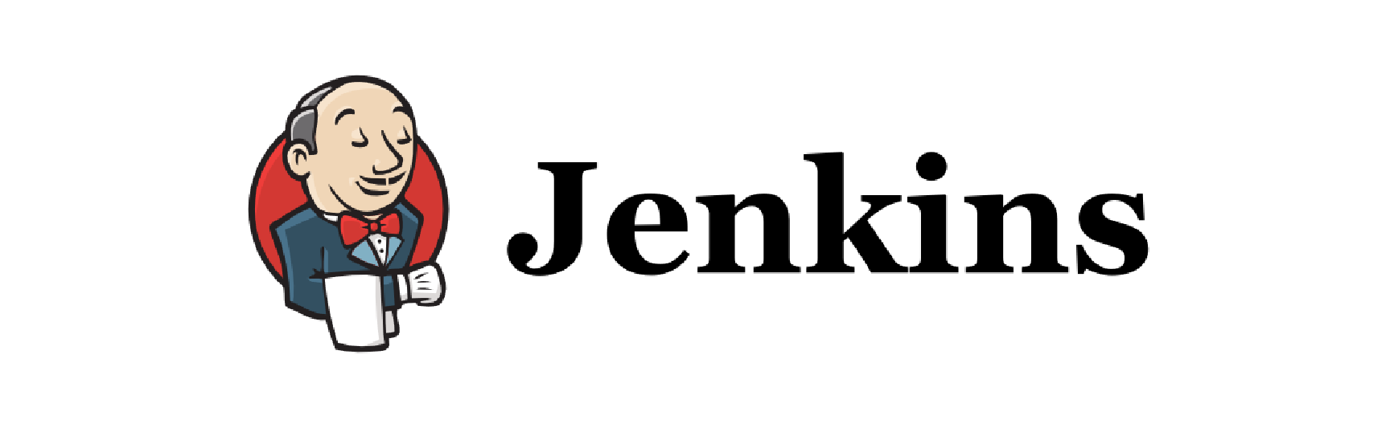
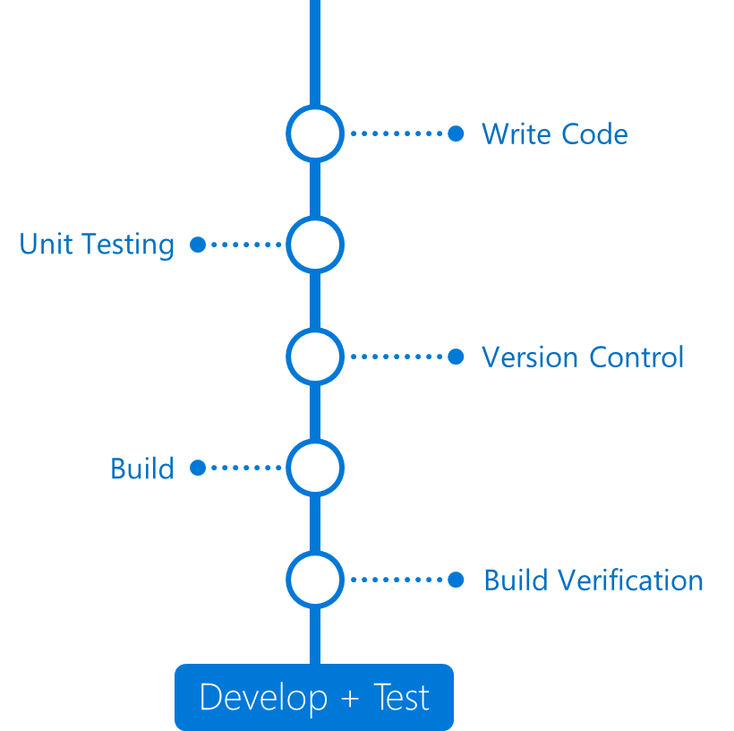
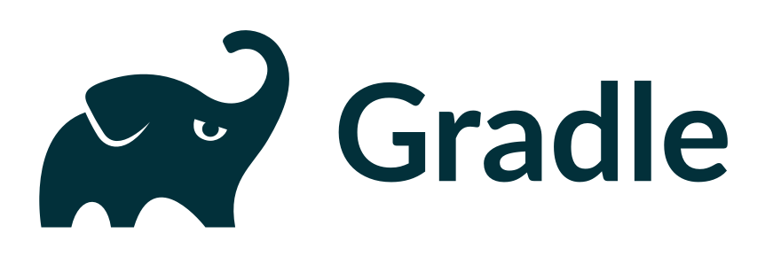
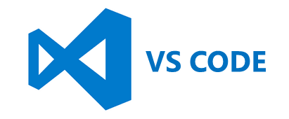

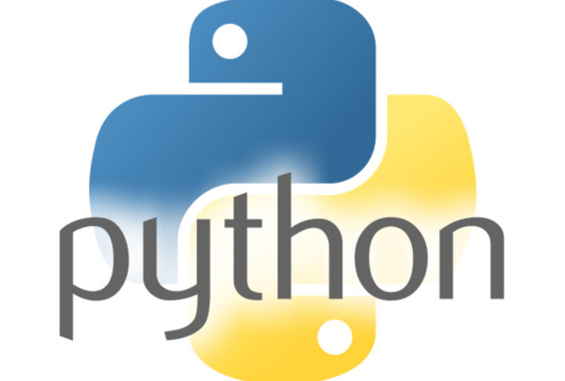
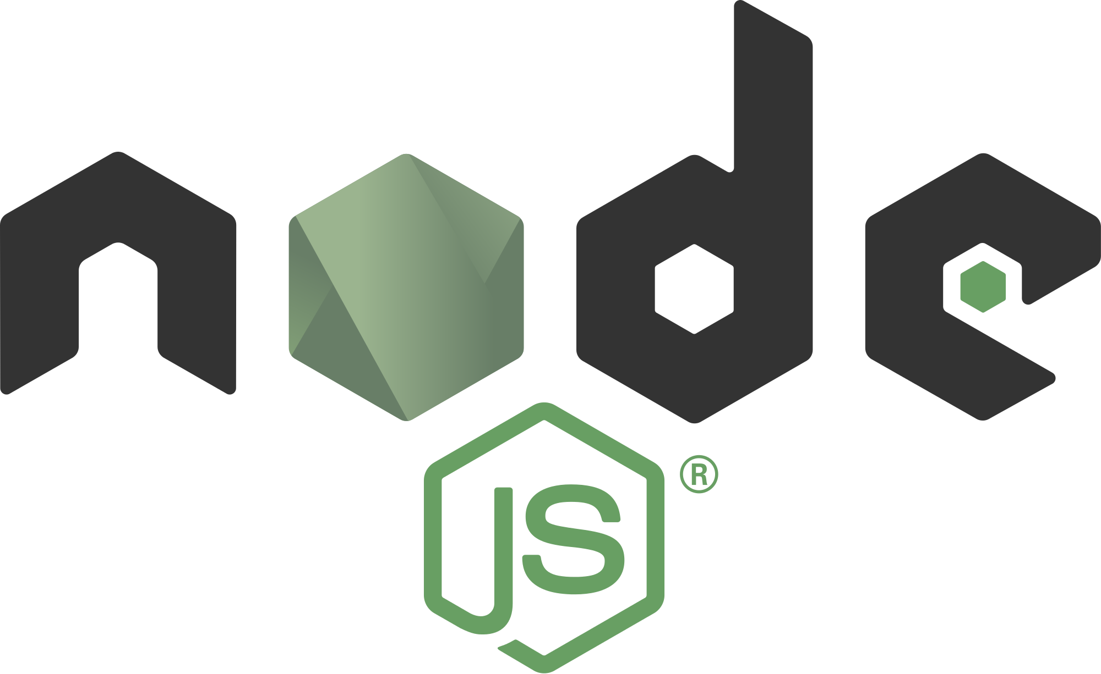
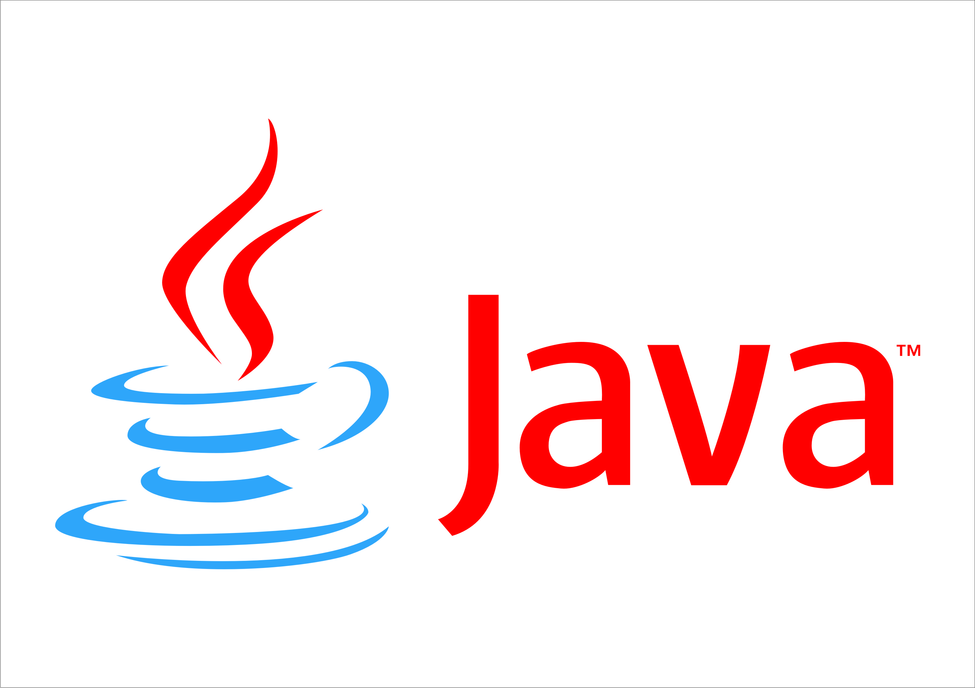

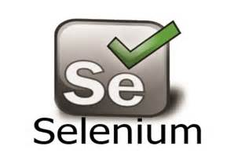
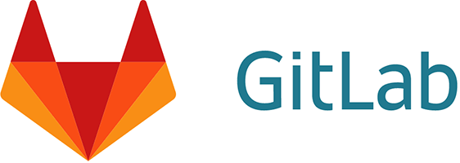
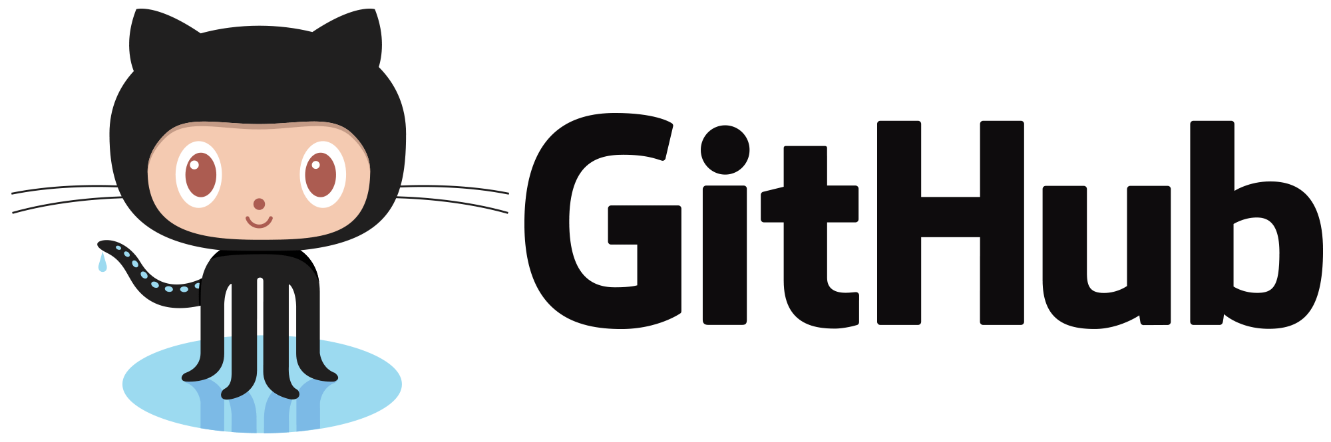

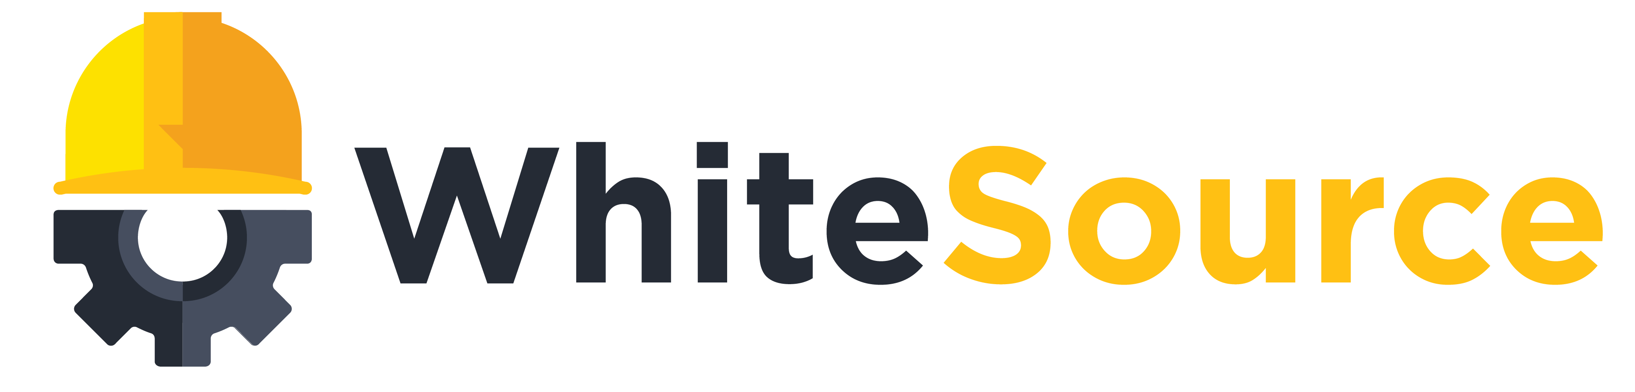
Any Language
Any Platform
DevOps
DevOps
Notes:
Now all of this requires the right products and tools to help enable all of this. So we need tools that will let us track our work throughout our sprint. We need source control systems that can corrolate our work to our checkins. We need automated build and release systems that can build on everycheckin, run all of our unit tests and automate deployment all the way to production. And we need systems in place to monitor our app in production.
Out there in the world, there are all sorts of tools that do these things. And Azure is an open system, which means you can keep using all of the DevOps tools you are most familiar with.
However, you can replace ALL of them with just one product. Azure DevOps

Slide 17
Le cas du cloud

Slide 18
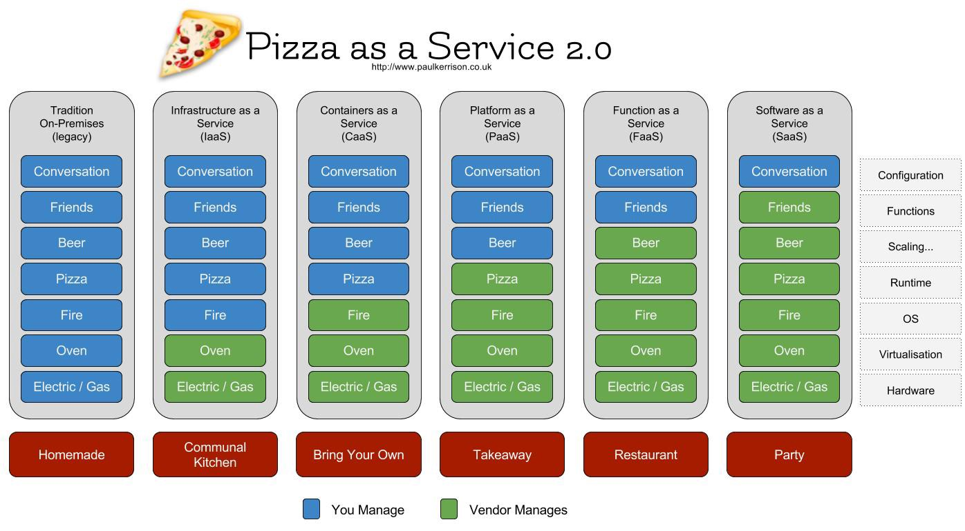
VS on-premise

Slide 19
Pas de communication = erreurs fatales
Convention de nommage
Les clés d’accès !
IP publiques
Wizard au sein du portail
Non application / connaissance des cloud design patterns
Et bien d’autres encore...

Slide 20
Demo

Slide 21
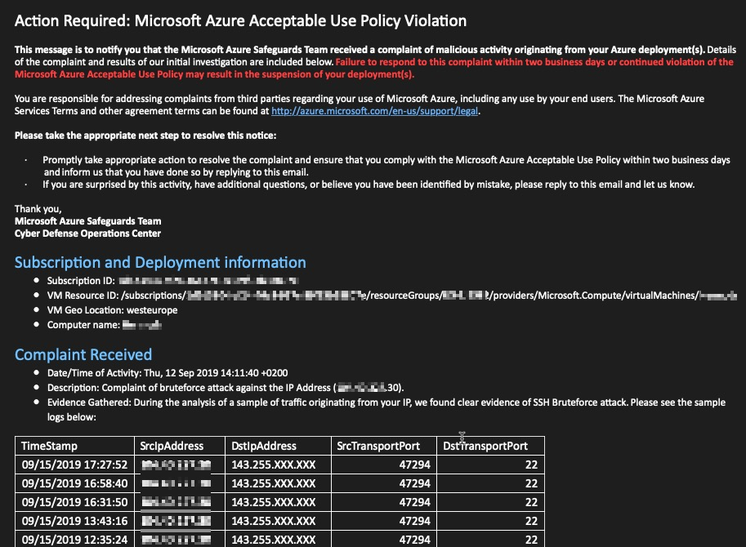

Slide 22
Conclusion
Le DevOps est une philosophie qui va bien au dela des process !
Le cloud nécessite une gouvernance et une coopération des dev et des ops…

